Slide 1
🛡️ CYBERSECURITY CAPSTONE PROJECT // EUREPOC ANALYTICS
Global Cybercrime Analysis & Intelligence Dashboard
Analyze 3,414 documented geopolitical cyber incidents, explore MITRE ATT&CK vectors, track nation-state attribution, and query our Groq AI Threat Analyst — all in one platform.
Presented by: Team Brainrot
Guide: Mr.S N Rao
Department: Computer Science Engineering
College : KLE Institute of technology
Academic Year: 2026 – 2027

Slide 2
OUR TEAM
Meet the Team
Shanya
Rahat
Viraj
Nihal
Vineet

Slide 3
INTRODUCTION
The Problem We're Solving
Analyzing global cyber warfare today means sifting through fragmented spreadsheets, unverified media reports, and complex multi-valued logs with no unified analytical view.
🧩 Fragmented Logs
🕵️ Attribution Blindness
💸 Skewed Cost Metrics
⏳ Slow Manual Queries
Raw CSV records lack visual correlation.
Stealth proxies obscure state responsibility.
Mismatched currencies distort damage figures.
Hours wasted filtering historical incidents.
💡 Our Solution: A unified Python & Streamlit platform transforming 3,414 verified EuRepoC records into interactive MITRE matrices, geospatial heatmaps, and an instant Groq AI Threat Analyst.

Slide 4
FEATURE OVERVIEW
What Our Platform Offers
📊 Executive KPI Deck
🌍 Target Heatmaps
🎯 MITRE ATT&CK Matrix
3,414 incidents tracked across 24 years.
Country and critical sector vulnerability views.
Initial access vectors and adversary goals.
🕵️ Attribution Tracker
💥 Disruption Telemetry
⚖️ Legal & State Response
State-sponsored APT group profiling.
Intensity scores and supply chain impact.
Sanctions, indictments, and response timelines.

Slide 5
STEP 1 · INTERACTIVE CONTROLS & KPI SUMMARY
Filter the Dataset & View Instant KPIs
3,414
42.9%
🎛️ Sidebar Filter Inputs
Date Range: 2000 → Late 2024 (92 undated isolated)
Verified Incidents
System Disruption
Receiver Country: US, Russia, Germany, UK, Ukraine
Incident Type: Data Theft, Disruption, Ransomware
1,670+
2.44
Attribution Filter: State Actors vs. Unknown Proxies
Data Theft Ops
Avg Intensity Score

Slide 6
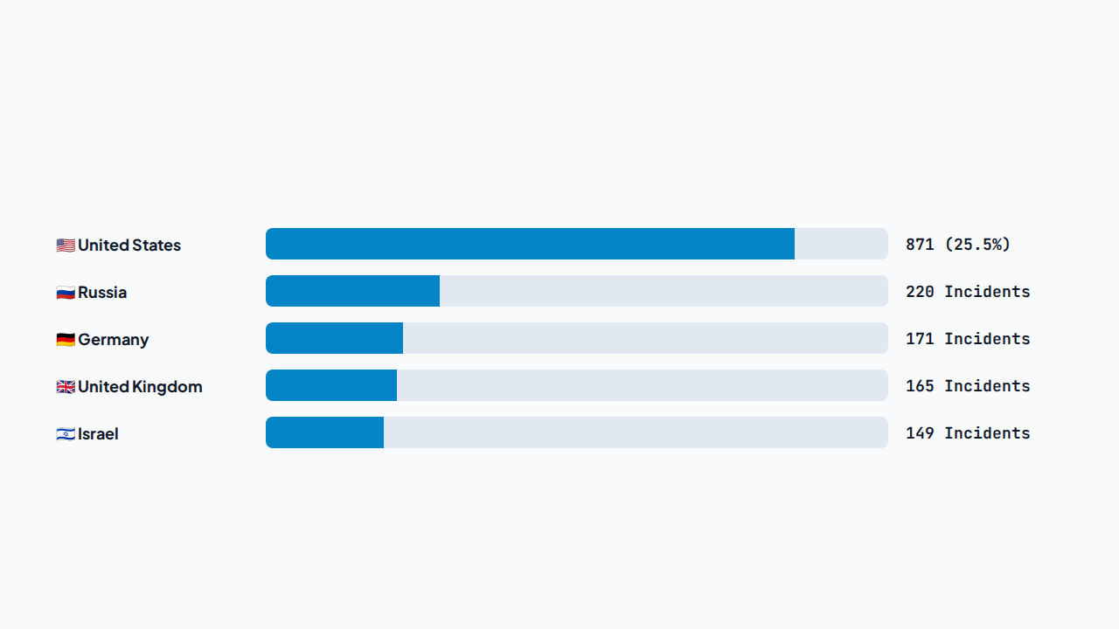
STEP 2 · GEOPOLITICAL TELEMETRY
Primary Targets & Vulnerable Sectors
Top Targeted Sectors: Critical Infrastructure (Energy, Water) · Public Administration · Defense & Aerospace · Healthcare

Slide 7
STEP 3 · TACTICAL INTELLIGENCE
MITRE ATT&CK Vectors & State Attribution
🔓 Initial Access & Objectives
🕵️ Top Attributed State Actors
Phishing Campaigns: 179 leading entry vectors
Russia (368+ ops): GRU, SVR, FSB-aligned units
Public App Exploits: 176 zero-day / web compromises
China (334+ ops): Strategic IP & state espionage
Data Exfiltration: 837 primary theft operations
Iran (154+ ops): Critical infrastructure disruption
DoS / DDoS Floods: 224 network outage attacks
North Korea (152+ ops): Financial & crypto heists
Ransomware Encryption: 189 extortion lockouts
Attribution Gap: Majority remain unattributed proxies

Slide 8
STEP 4 · DAMAGE & RETALIATION ANALYSIS
Operational Impact & State Responses
🏥 System Paralysis
💱 Currency Integrity
⚖️ 6–18 Month Lag
Halts hospital surgeries, port logistics, and power grids.
Separates USD vs. EUR without assuming zero for missing data.
Sanctions and indictments trail live attacks by over a year.

Slide 9
AI ASSISTANT · GROQ INTEGRATION
Real-Time AI Cyber Threat Analyst
⚡ Powered by Groq: Instant token streaming via Llama & Qwen models.
🛡️ Ask AI Analyst (Live Widget)
User: "Which APT groups targeted European energy grids in 2023?"
🔒 0% Hallucination: Strictly grounded on verified EuRepoC records.
AI Analyst: "Based on verified EuRepoC records, Sandworm (GRU Unit 74455) and APT28 executed 14 documented operations against European energy infrastructure..."
💬 Always-On Widget: Floating 🛡️ Ask AI Analyst button on every view.
📑 Cited Briefings: Indexes incident IDs, dates, threat groups, and summaries.

Slide 10
UNDER THE HOOD · TECH STACK & ARCHITECTURE
System Architecture & Technology Stack
Layer | Technology | Core Purpose
Frontend & UI | Streamlit + Custom CSS | Interactive multi-filters, date sliders & dark theme
Analytics Engine | Python 3.14, Pandas, NumPy | Multi-valued token parsing & crosstab aggregations
Visualization | Matplotlib & Seaborn | High-DPI dark-mode charts & MITRE matrices
AI Intelligence | Groq API (Llama / Qwen) | Zero-hallucination RAG threat briefings
Dataset & Hygiene | EuRepoC (3,414 Records) | Null isolation, date normalization & verified filings

Slide 11
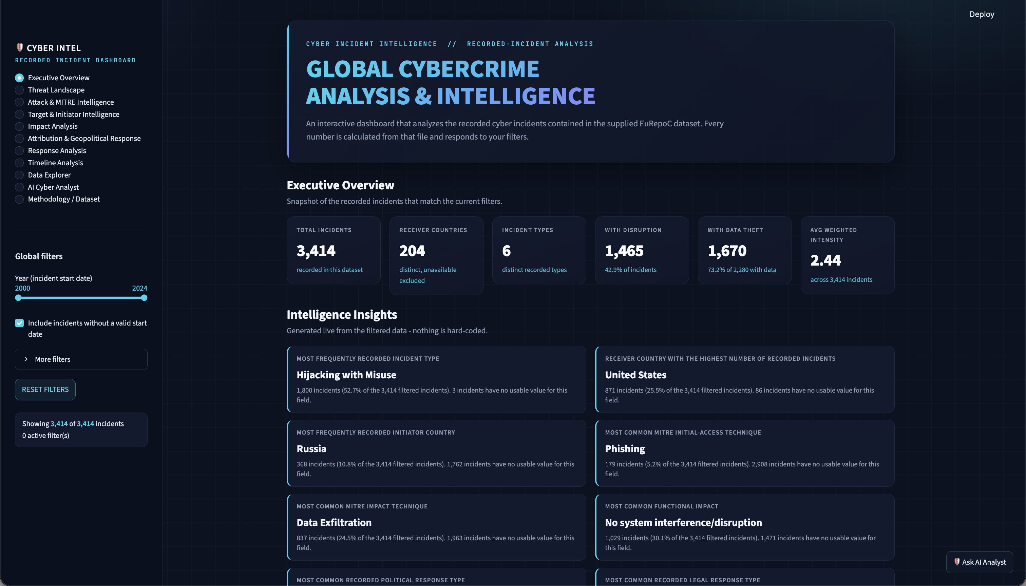
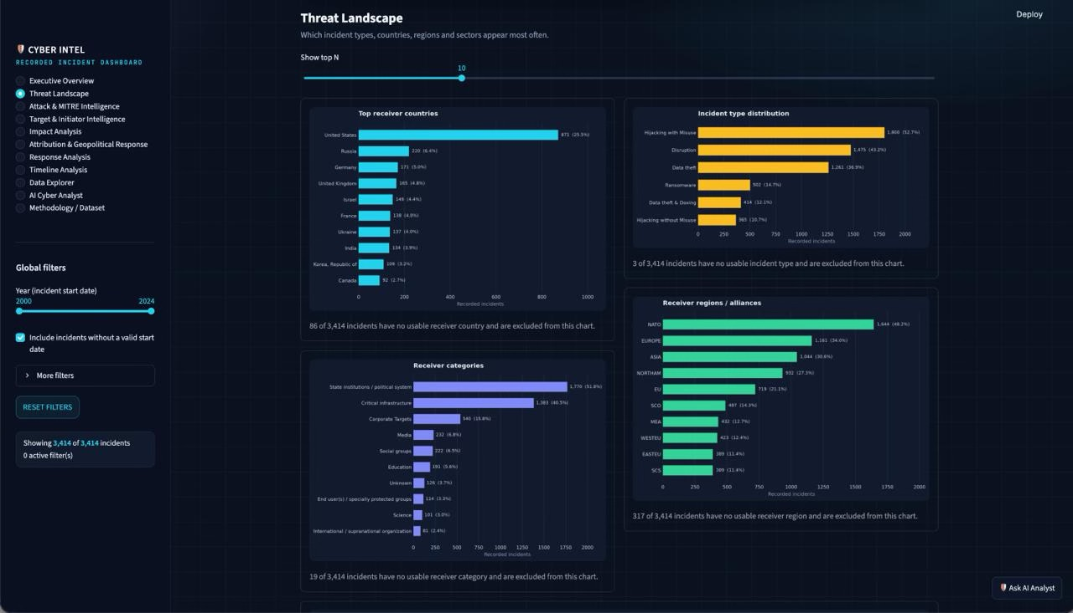
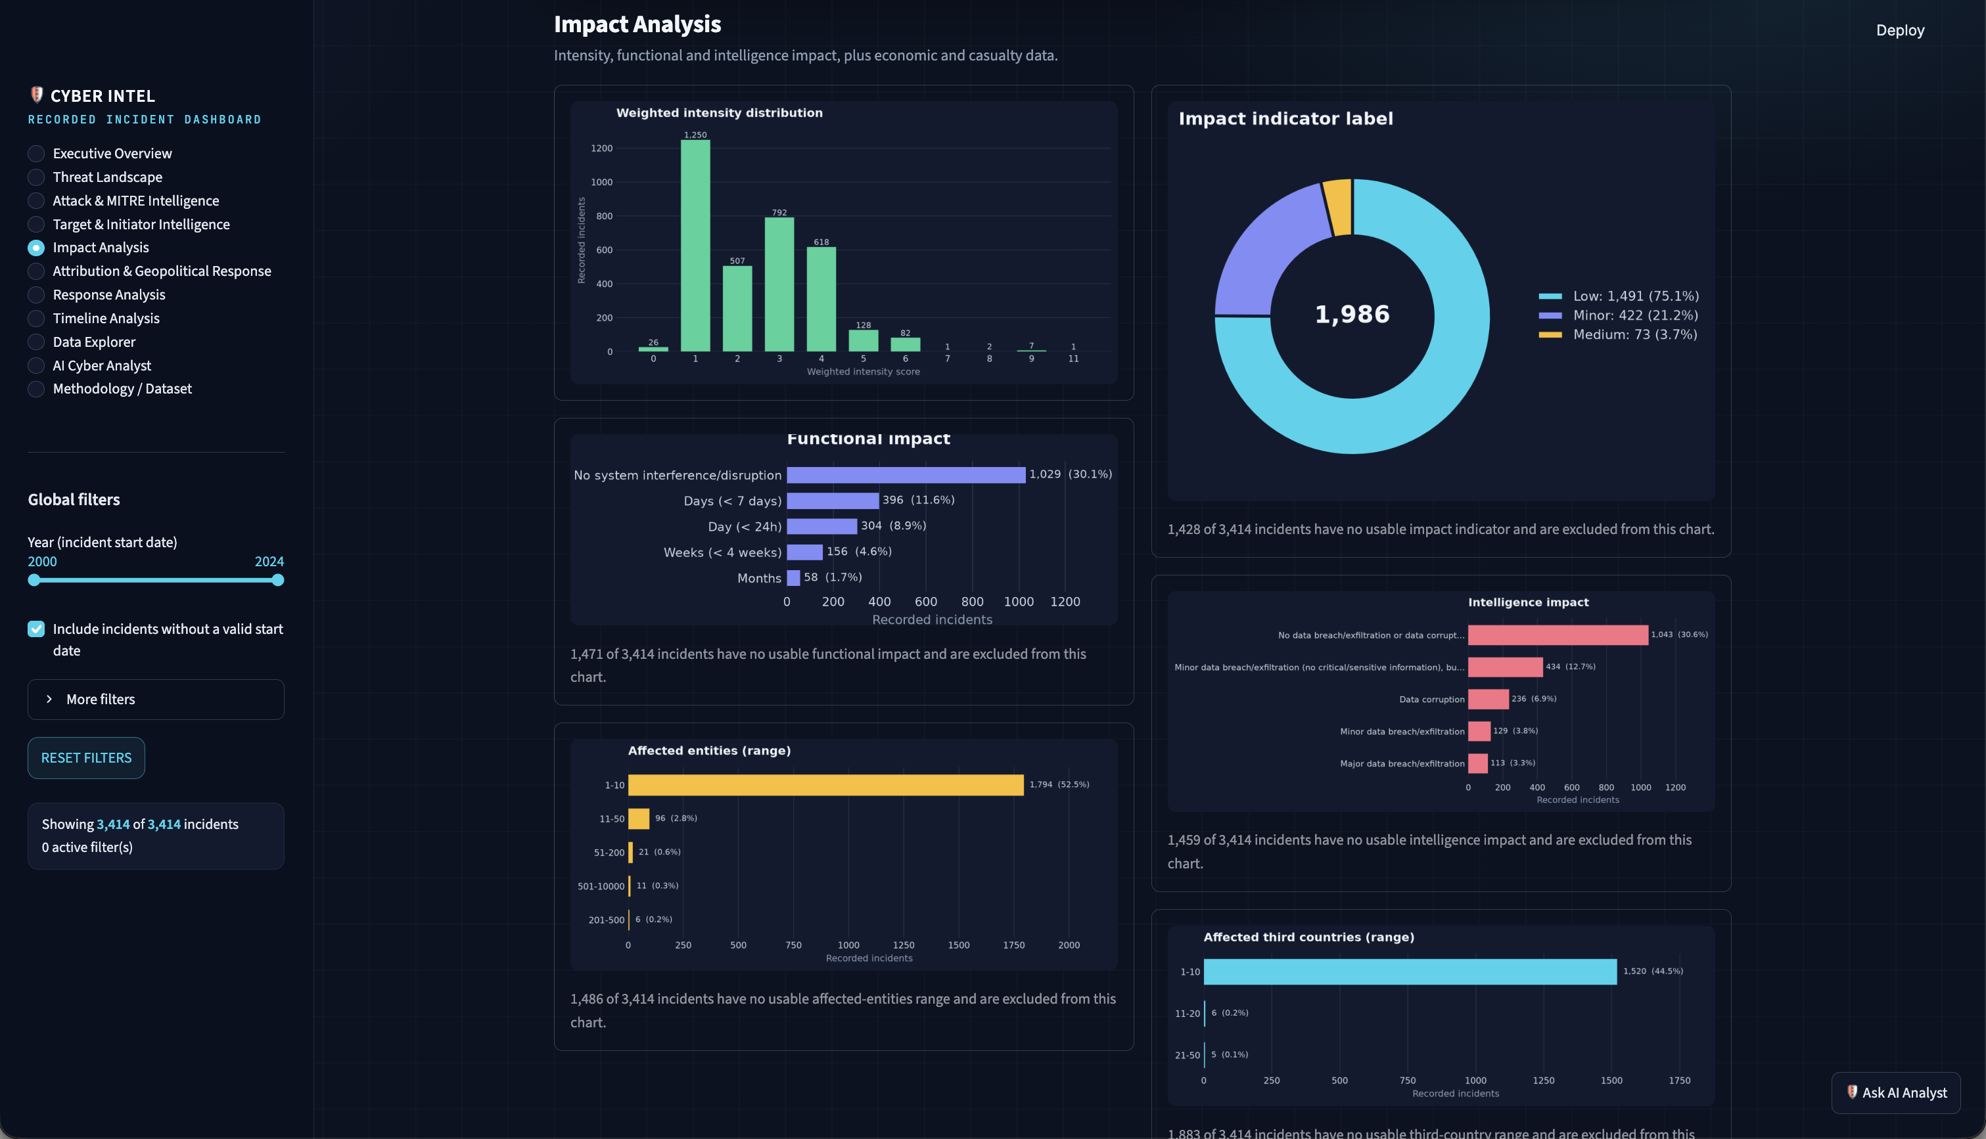
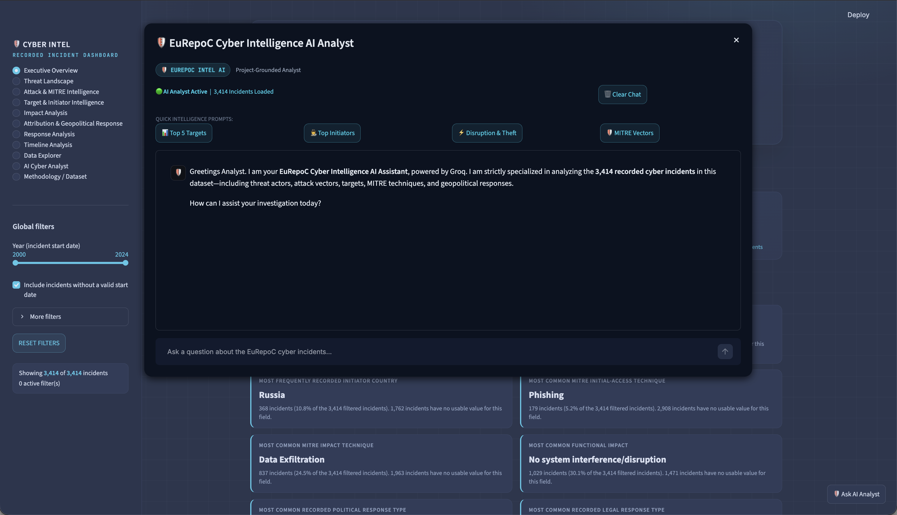
Snapshots

